Slide 1

Group members:
Adham mohamed:2202724
Amira Fayez: 2102344
Menna sobhi :2202434
Rowan Osama: 2202736
Begad Mounir: 2200120

Slide 2
Project idea :
Family social network

Slide 3
Introduction:
What is the Family Social Network?
A platform to connect family members, preserve lineage, and strengthen familial bonds.
Purpose and Vision:
Promote interaction within families and document their genealogy for future generations.

Slide 4
Requirements for a Family Social Network Platform:
1. User Registration & Profiles:User Accounts: Users must be able to create personal profiles using their email or social media accounts (optional).Profile Details: Users should input personal details such as name, relationship status, bio, photo, and birthdate.Privacy Settings: Ability to control who can view specific details (private, family only, public).
2. Family Tree Feature:Family Tree Generation: Users can input details about family members and their relationships to build a dynamic family tree.Genealogical Records: A system to record and display lineage (parents, grandparents, children, etc.).Family Ties Visualization: A graphical representation of family connections (parents, children, siblings, grandparents, etc.).Multi-Generational Tracking: Option to add several generations of family members to the tree.Interactive Tree: Users can click on members of the family tree to view detailed profiles, photos, and history.
3. Posts and Content Sharing:Posts & Comments: Users can create text, image, and video posts and comment on each other's posts.Likes and Reactions: Similar to Facebook, users can "like" posts, leave comments, and use emojis for reactions.Content Types: Support for various media (photos, videos, documents, etc.).Tags and Hashtags: Users can tag family members in posts or use hashtags to group content by themes.

Slide 5
Requirements for a Family Social Network Platform:
4. Invitation and Subscription:Invite Family Members: Users can send email invitations to family members to join the platform.Subscription Management: Users can subscribe/unsubscribe from family members’ updates.Family Group Creation: Ability to create private family groups where specific people (e.g., siblings or extended family) can interact.
5. Moderation and Privacy:Content Moderation: Administrators or designated moderators can monitor posts and comments to ensure appropriate content is shared.Privacy Options: Users can set posts to be visible only to certain family members or groups.Report Functionality: Allow users to report inappropriate content.
6. Messaging and Communication:Direct Messaging (DM): Private messaging between family members.Group Chats: Create group chats for family events, holidays, or specific groups (e.g., cousins, parents).Notifications: Users receive notifications for messages, family updates, and comments.

Slide 6
Requirements for a Family Social Network Platform:
7. Timeline and Feed:Personalized News Feed: A stream of updates, posts, and interactions from family members.Chronological Order: Posts are organized by date and time.Sorting Options: Ability to filter the feed (e.g., by photos, videos, or important events).
8.Admin & Moderation Tools:Family Admin: Admin roles for creating and managing family groups, accepting/rejecting family member requests.Content Moderation: Ability to remove inappropriate posts or comments.

Slide 7
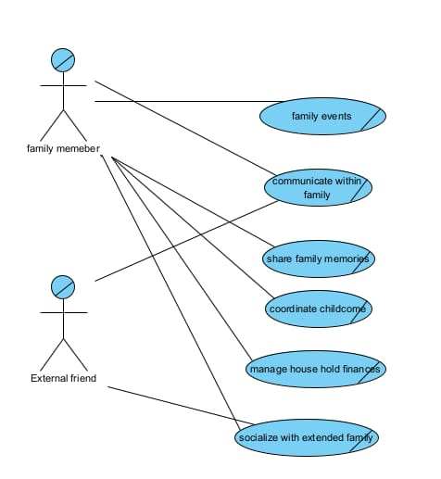
Business use case

Slide 8
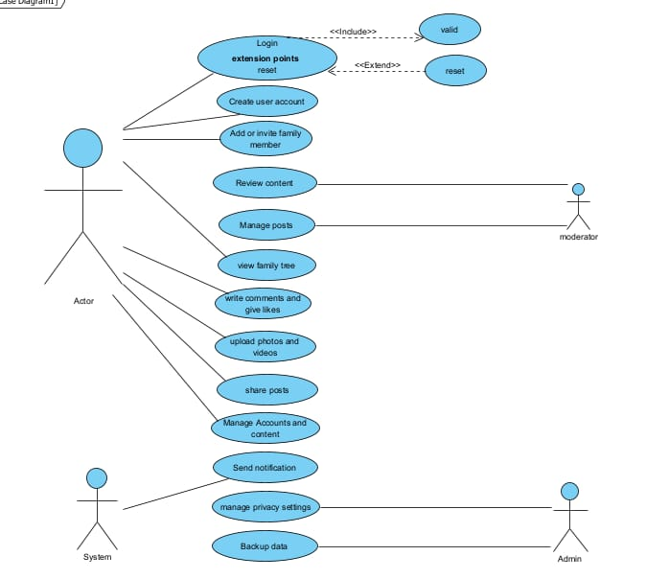
Use case Diagram

Slide 9
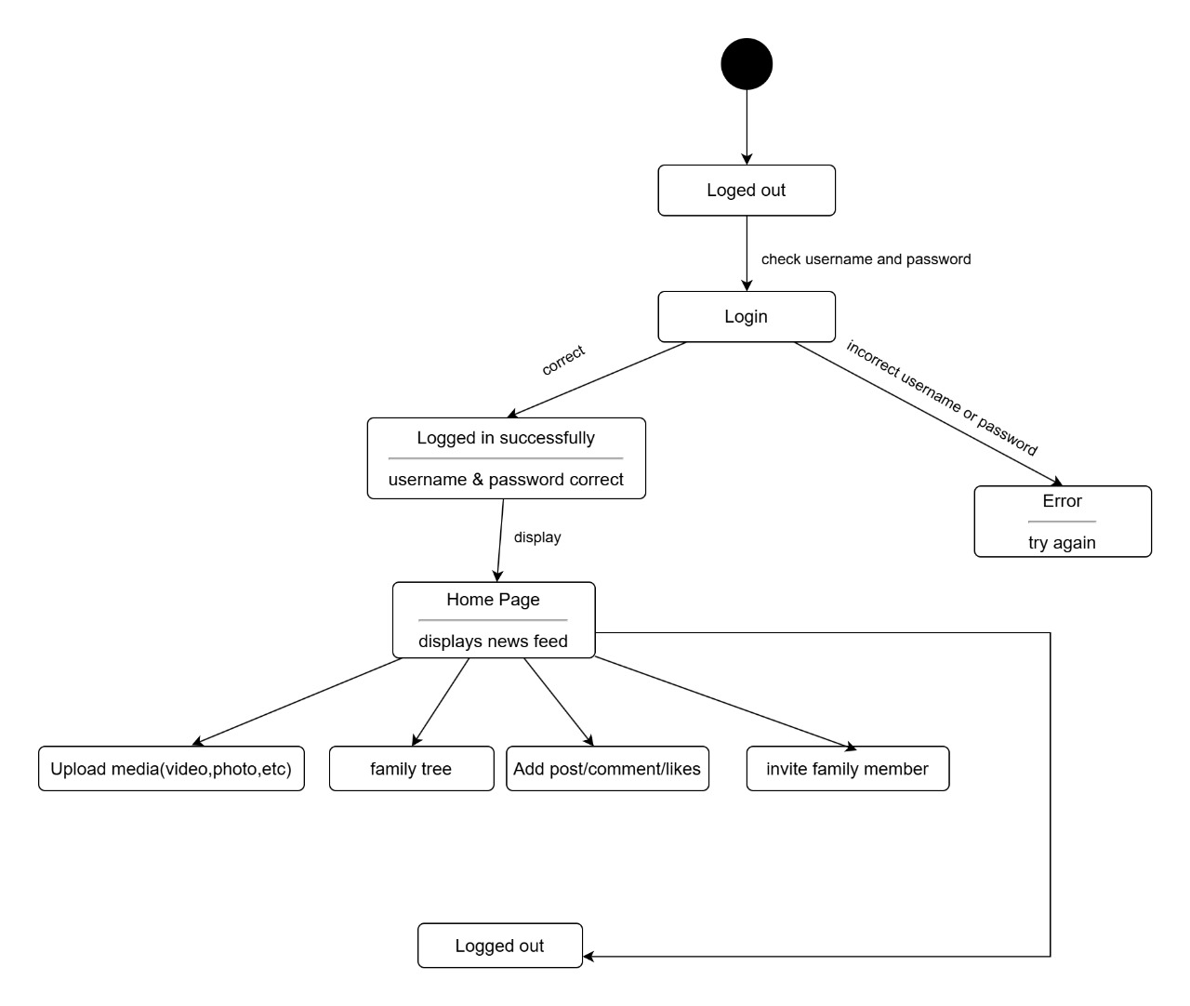
statechart diagram

Slide 10
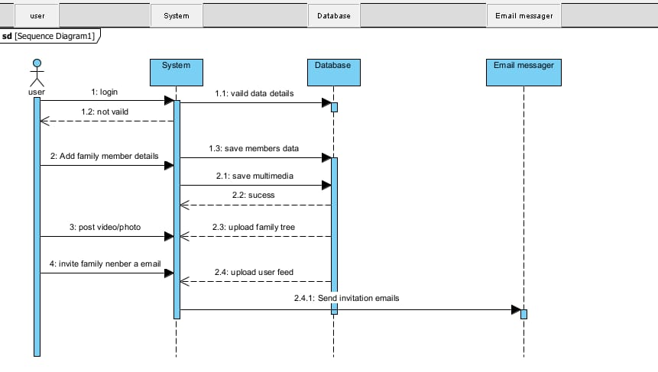
sequence diagram

Slide 11
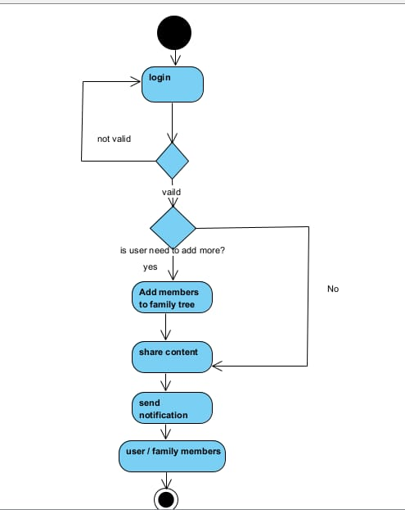
Activity diagram

Slide 12
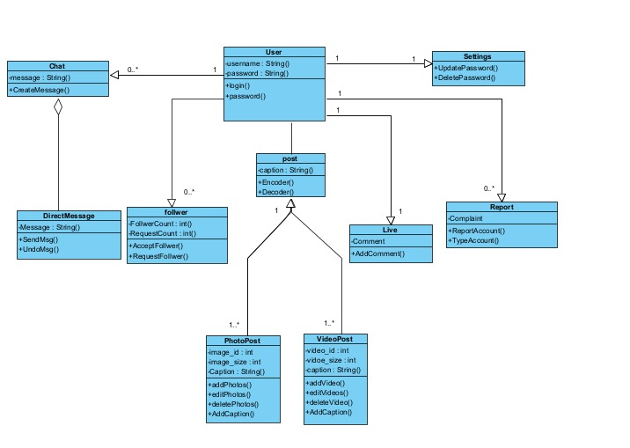
Class diagram

Slide 13
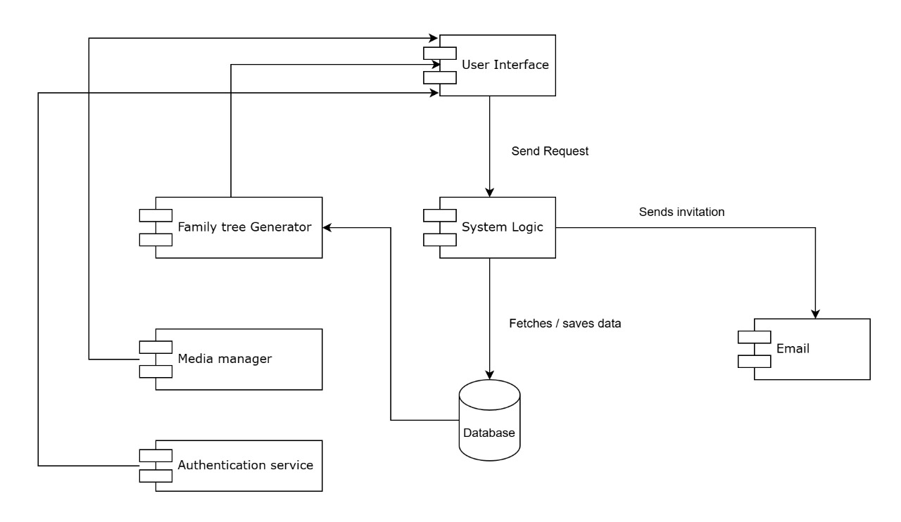
Component diagram

Slide 14
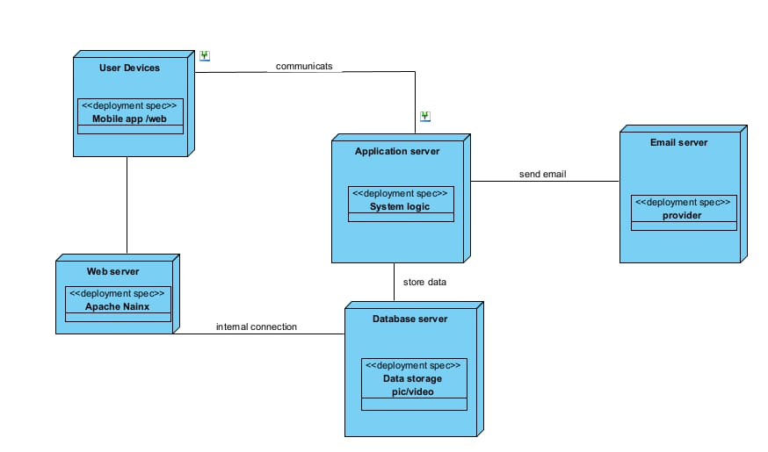
Deployment diagram

